Slide 1


Module 11 – Health Management Reports

Slide 2
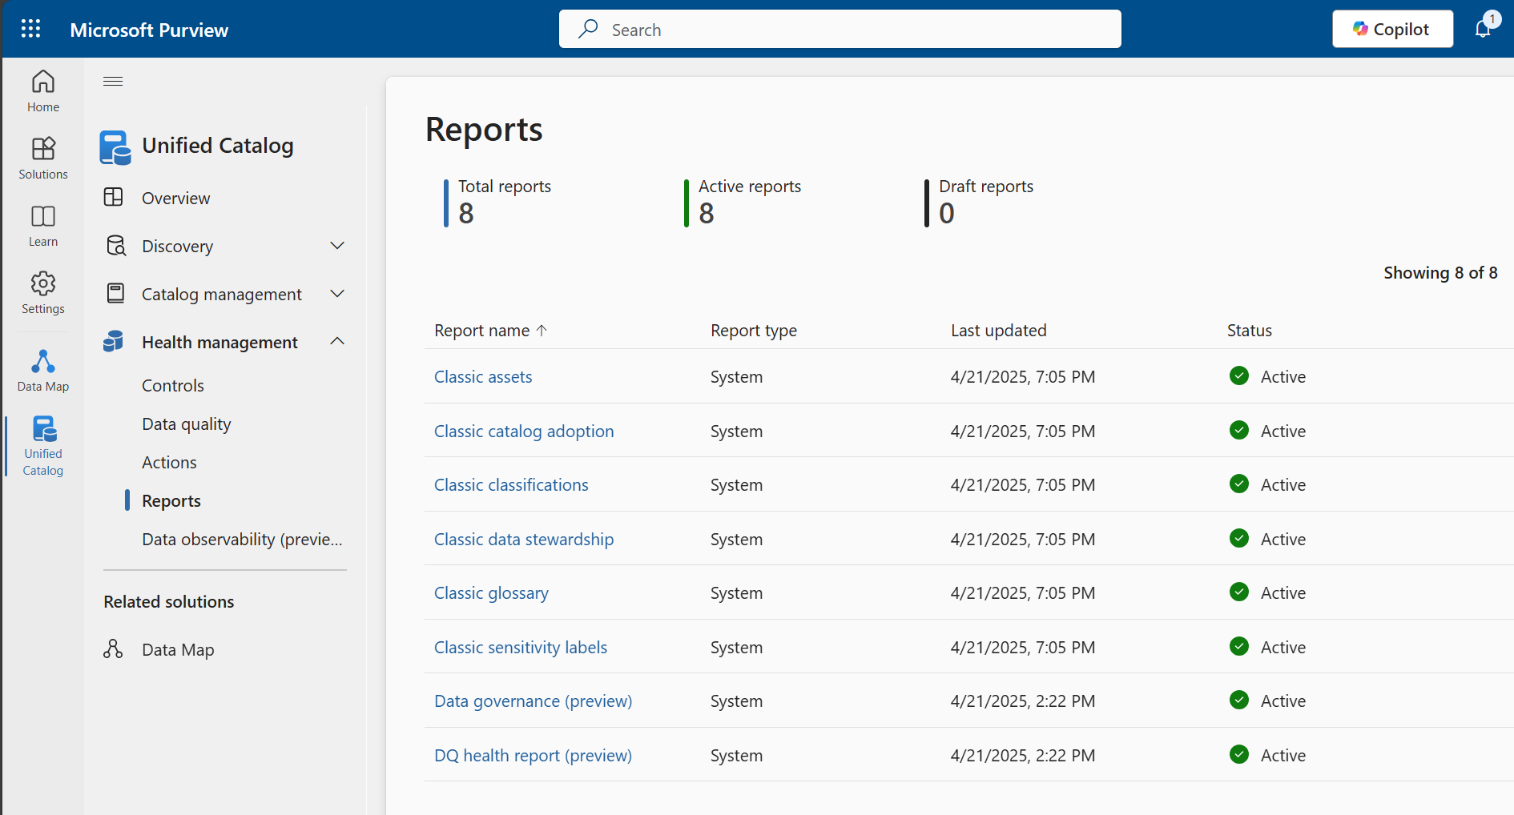
Current Reports
Notes:
Currently, there are 8 out of the box reports available in Purview:
6 are legacy reports which have been prefixed with the word "Classic" to indicate that they are being deprecated in favour of the new reports.
Two new reports are currently in preview

Slide 3
Data Governance (preview) Report
Provides a data governance overview with actionable insights into the health of the data estate based on the controls configured for:
Access and use
Discoverability
Estate curation
MD quality management
Trusted data
With deeper dives from data product and glossary perspectives
Facilitates tracking of data governance improvements
Data Health Controls must be set up for the report to display data
Notes:
Also, deeper dive into the health of your data at from a data product perspective looking at percentages of data products which have classifications, data assets, self-service access ,policies and glossary terms, owners and descriptions attached.

Slide 4
Data Quality (preview) Report
Provides insights into the health of the data estate based on the data quality rules configured
Overview page shows a quick snapshot of the Overall score, the accuracy, completeness, conformity, uniqueness, consistency and timeliness and uniqueness scores
Details page provides a more detailed view of the data quality rule results and the data assets that are failing the rules
Data Quality rules have to be set up and scans run as the report depends on the scan output
Helps with monitoring, identifying issues, measuring the effectiveness of data quality initiatives, communicating to stakeholders
Notes:
If customers don't use Data Quality feature, the Data Quality Health report shows blank because Data Quality Health report is created using data that are generating from Data Quality scan feature.

Slide 5
Building Custom Reports: Self-serve analytics and insights (preview)
3NF data model of metadata can be pushed into Fabric or ADLS
Enables self-service analytics
List of tables and keys
Instructions for Fabric set up
Instructions for ADLS set up

